Slide 1


BUSINESS INTELLIGENCE SYSTEM FOR OPERATIONAL EFFICIENCY IN HOSPITALS
End-to-end BI project: From data to decisions
BY: Rania Mestiri
This project focuses on the healthcare industry, specifically a town hospital facing operational inefficiencies.
The objective of this Business Intelligence solution is to provide management with actionable insights to optimize hospital processes and improve patient experience.

Slide 2

ROADMAP
Business Problem
Data & Methodology
Star Schema & KPIs
Dashboards
Insights & Recommendations
Limitations & Improvements
Conclusion

Slide 3


BUSINESS
CONTEXT
KEY ISSUES :
Long patient waiting times, unequal workload distribution among doctors and departments, and declining patient satisfaction.
SYSTEM OBJECTIVES :
Identify root causes of waiting times
Optimize doctor and staff scheduling
Balance workload across departments
Improve overall patient experience
A hospital provides a wide range of services across multiple departments.
PROBLEM : Its operational processes have become insufficient compared to the increasing patient volumes and growing care demands.

Slide 4
DATA OVERVIEW
METHODOLOGY
The analysis is based on a simulated operational dataset of 12,000 patient visits.
Each record corresponds to a single patient appointment handled by a doctor in a specific department during a defined shift.
Core business event:
One row = one patient visit
Key data types include :
Time (check-in, consultation, checkout)
Doctor workload metrics
Department capacity
Satisfaction score
Process followed :
Business Understanding → Data Preparation → Data Modeling → Visualization → Insights.
Identification of a core business event : foundation for data modeling and analysis.
Raw data generated using a Python code.
Dataset transformed through an ETL pipeline, and stored in a PostgreSQL database designed using a dimensional star schema.
Analytical queries and DAX measures applied to support interactive visualization in Power BI.

Slide 5
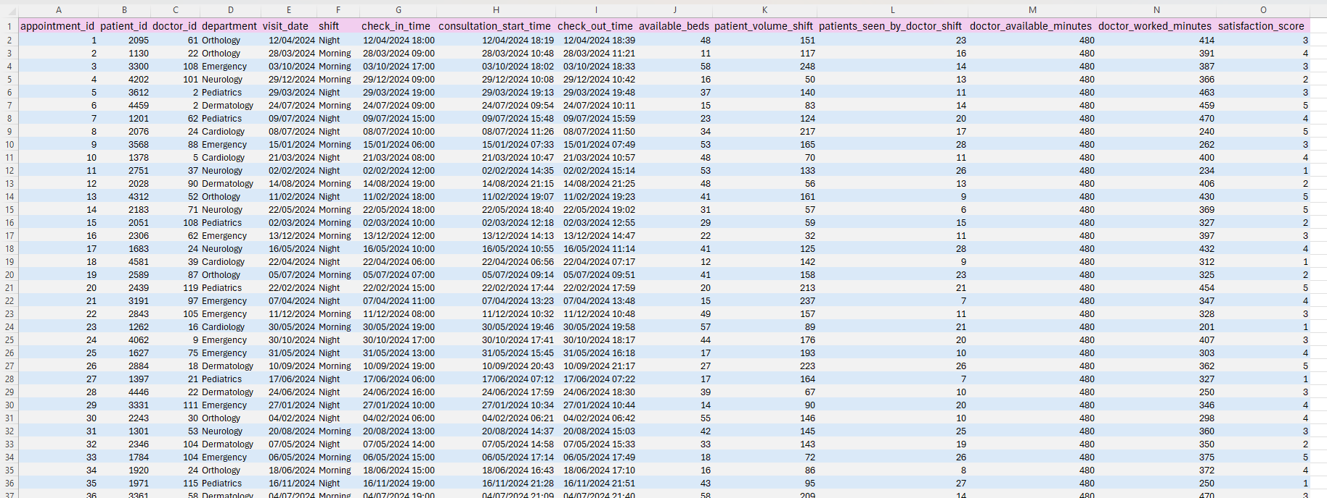

EXTRACT OF THE RAW DATASET :
ETL STEPS APPLIED :
Removal of duplicates
Handling of missing values
Standardization of date & time formats
Creation of calculated fields :
waiting_time_minutes
consultation_duration_minutes
doctor_utilization_rate

Slide 6
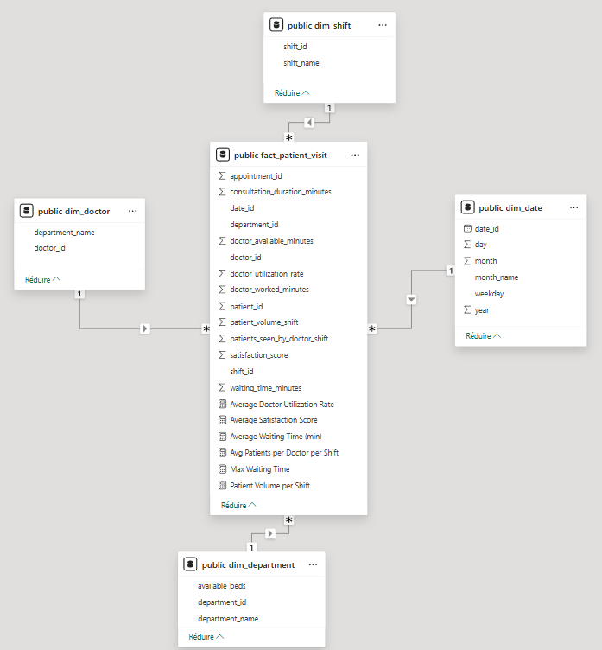
THE DIMENSIONAL
STAR SCHEMA
Fact table : Patient visit
Dimensions :
Date, Department, Doctor, Shift
Key KPIs & DAX Measures :
Average Patient Waiting Time
Maximum Waiting Time per Department
Patient Volume per Shift
Average Doctor Utilization Rate
Average Patients per Doctor per Shift
Average Satisfaction Score

Slide 7
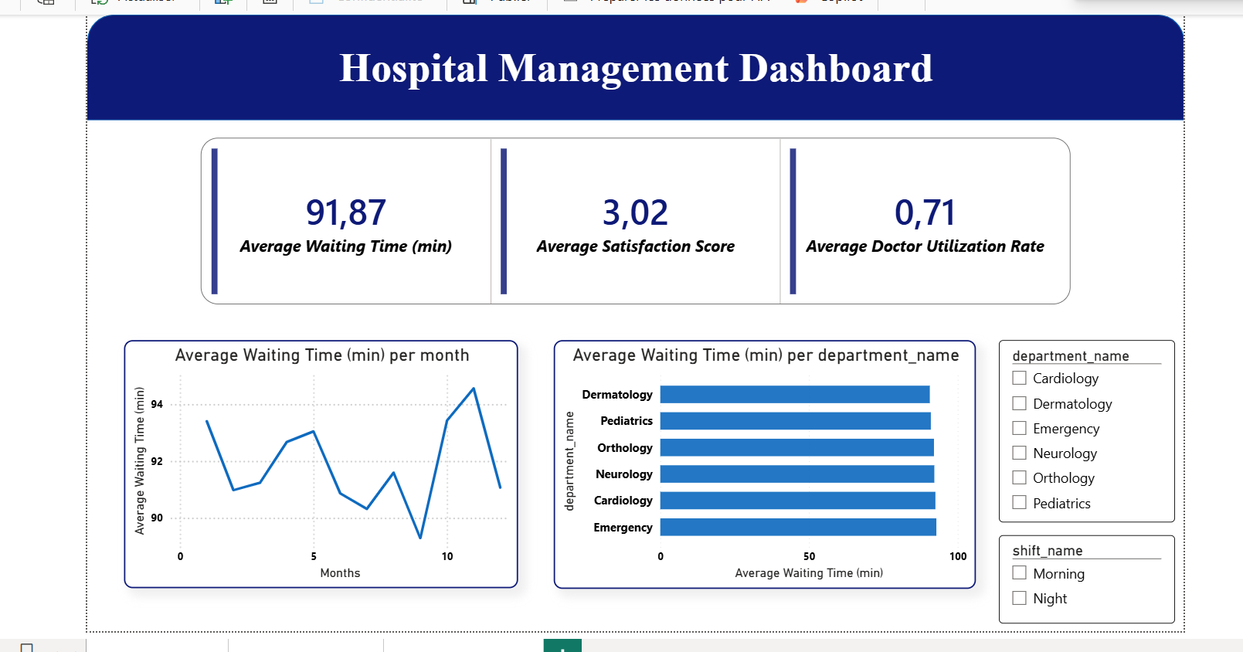
EXECUTIVE DASHBOARD

Slide 8
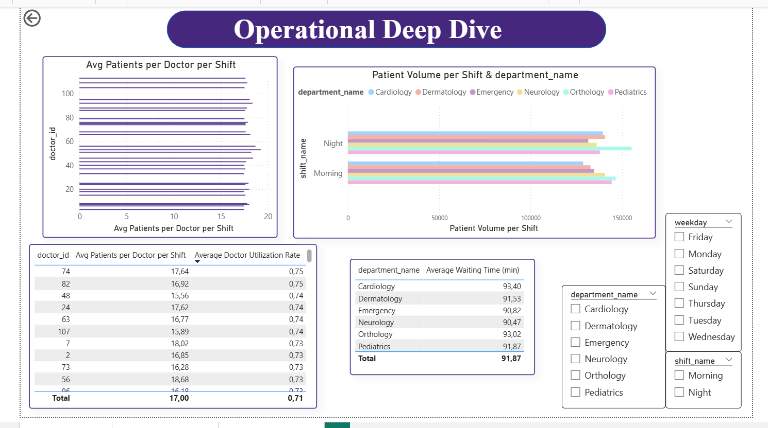
DEEP DIVE DASHBOARD

Slide 9
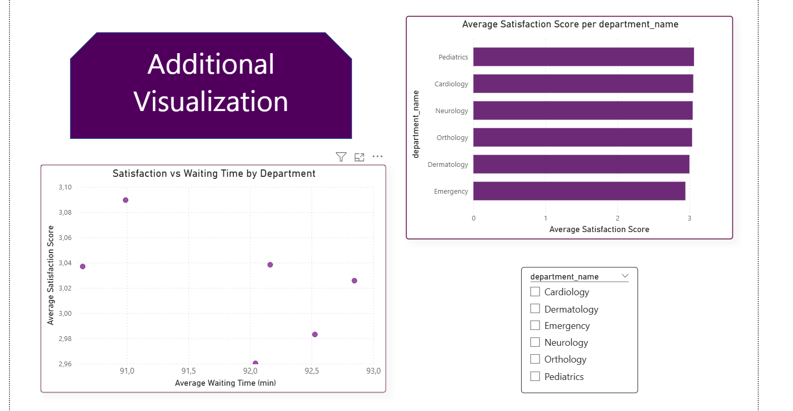
ADDITIONAL ANALYSIS DASHBOARD

Slide 10

KEY INSIGHTS
Business Impact :
Declining patient satisfaction.
Increased staff burnout.
Inefficient resource allocation.
Potential revenue loss and reputational risk.
Recommendations :
Optimize doctor scheduling during peak periods.
Rebalance workload across doctors.
Implement dynamic staff allocation.
Monitor doctor utilization as a key performance indicator.
Increase capacity in high-pressure departments.
Use satisfaction scores as an operational feedback tool.
Findings :
- Waiting times vary across departments; Emergency and Cardiology show the longest waiting times.
- Workload is unevenly distributed; some departments are more overloaded than others.
- Doctor utilization imbalance, some doctors are overutilized while others are underutilized.
- Negative relationship between waiting time and satisfaction; longer waits lead to lower patient satisfaction.
Operational inefficiencies are structural, not random.
Notes:
(il n’existe pas d’ID de concepteur, car ils reposaient sur les diapositives de masque par défaut déjà présentes dans l’argumentaire.

Slide 11

Limitations :
The analysis is based on a simulated dataset and may not fully reflect the complexity of real hospital environments.
Factors such as emergency cases, patient demographics, medical severity, are not explicitly modeled.
In this project, logical assumptions inspired by real-world cases were made to ensure analytical consistency and data coherence.
Future Improvements :
Integration of real-time hospital data.
Inclusion of patient demographic and clinical complexity indicators.
Predictive analytics to forecast patient demand.
Advanced time-series analysis for seasonal trends.

Slide 12
CONCLUSION
Data-driven analysis in hospital environments enables management to understand patient flow dynamics, optimize staff utilization, and improve service quality.
The findings emphasize that reducing waiting times, balancing workloads, and monitoring satisfaction are drivers of healthcare performance.
Implementing the recommended actions can help the hospital improve patient experience, protect staff well-being, and strengthen its operational sustainability.

Slide 13

THANK YOU
RANIA MESTIRI
J.ACCT/IT

